Slide 1
05. Splines & Subdivision Curves
Dr. Hamish Carr

Slide 2
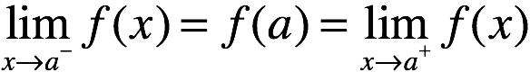
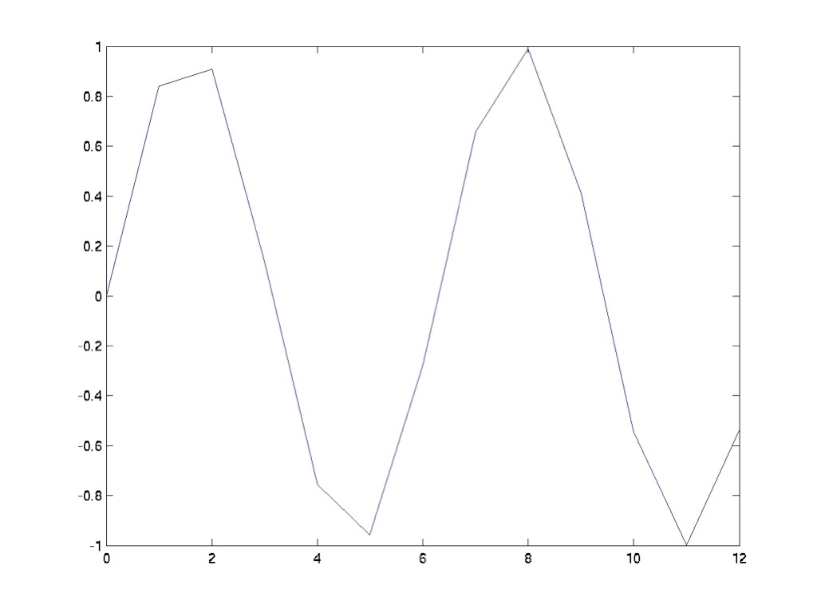
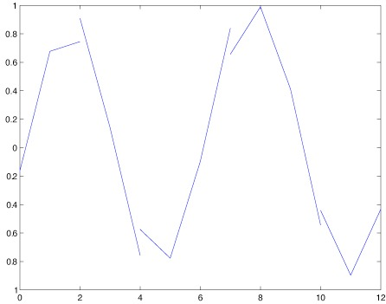
Continuity
A continuous function f(x) satisfies:
Also called C⁰ continuous
Discontinuous
Continuous

Slide 3
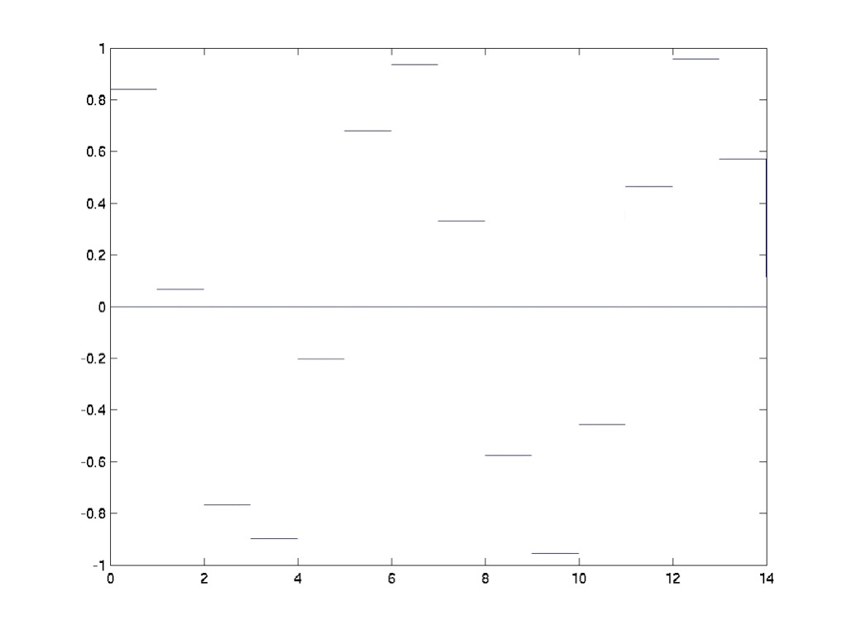
Continuous ≠ Smooth
Not smooth
Why not?
Slope (derivative)
slope is discontinuous

Slide 4
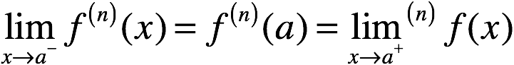
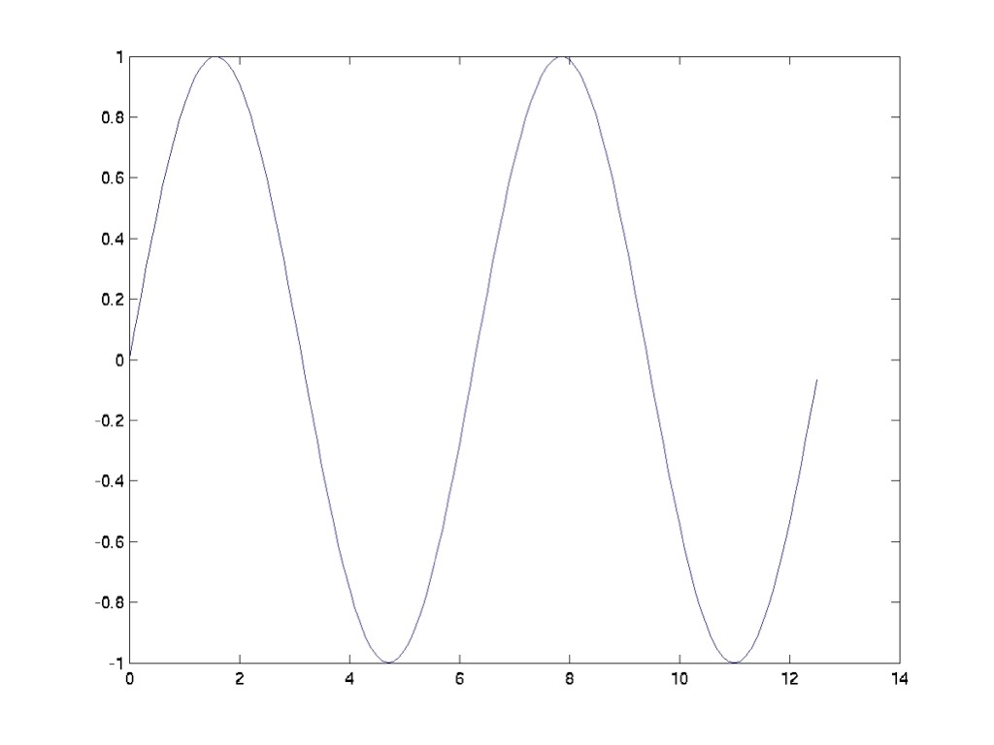
C^{n} Continuity
A function f(x) is C^{n} continuous if:
C⁰ Continuous
C¹ Continuous
actually C∞

Slide 5
Desiderata
Smooth curves -> at least C¹ continuity
Mathematically simple -> polynomials
Closed form intersections -> polynomials
Computationally efficient -> low-order
Interpolating -> pass through points
Local control -> artists can use them
Bounded interpolation -> ditto

Slide 6
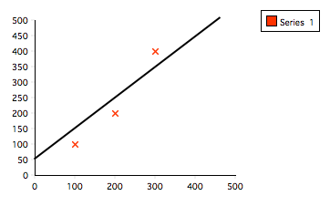
Least Squares
Find one line that fits a set of points
Minimise this: solve for a, b
Non-interpolating
Only gives you a line

Slide 7
Lagrange Polynomials
Interpolating (+)
Polynomial (+)
High-order (-)
Inefficient (-)
No closed form (-)
No local control

Slide 8
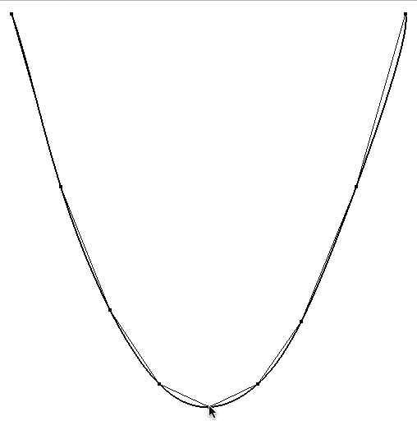
Lagrange Example

Slide 9
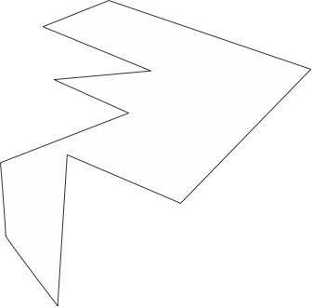
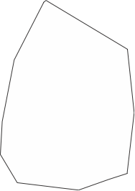
Convex Polygons
In a convex polygon,
if p,q are in the polygon
then so is the line pq
p
p
p
q
p
q
q
q
Convex
Concave

Slide 10
Convex Hull
For a set of points
the convex hull is the
smallest convex polygon
that contains all the points

Slide 11
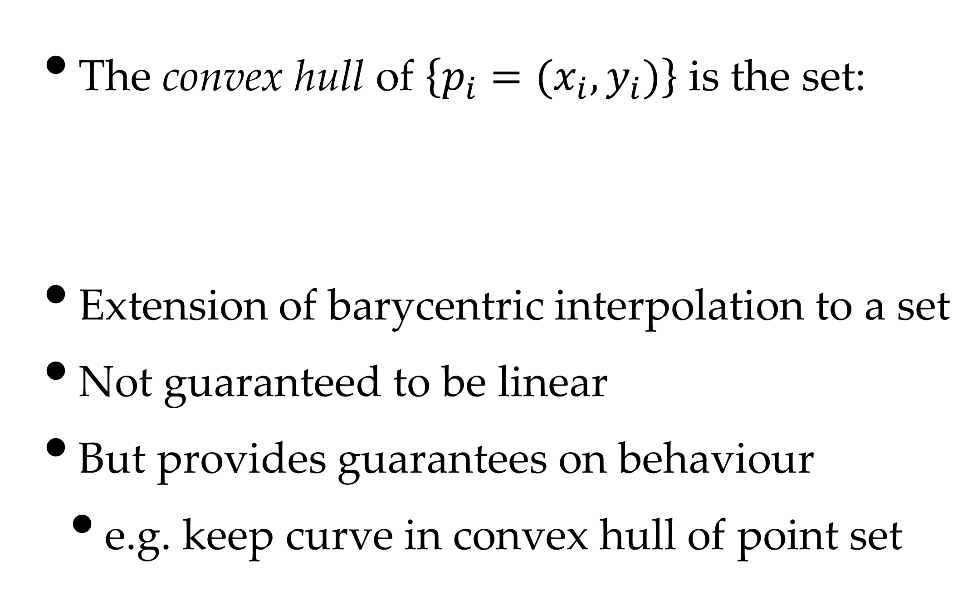
Formal Definition
The convex hull of $\left\{p_{i}=(x_{i},y_{i})\right\}$ is the set:
Extension of barycentric interpolation to a set
Not guaranteed to be linear
But provides guarantees on behaviour
e.g. keep curve in convex hull of point set

Slide 12
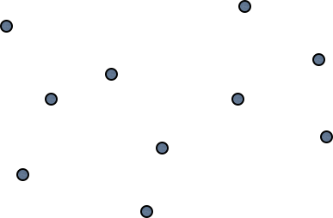
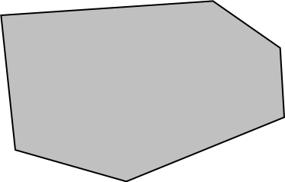
Convex Hull Example
All linear combinations of points
Algorithms later ...

Slide 13
Interpolating Conditions
Extra interpolating points are difficult
So add:
interpolating vectors (Hermites)
non-interpolating points (Béziers / Splines)
They're all equivalent anyway
And turn out to require cubic polynomials

Slide 14
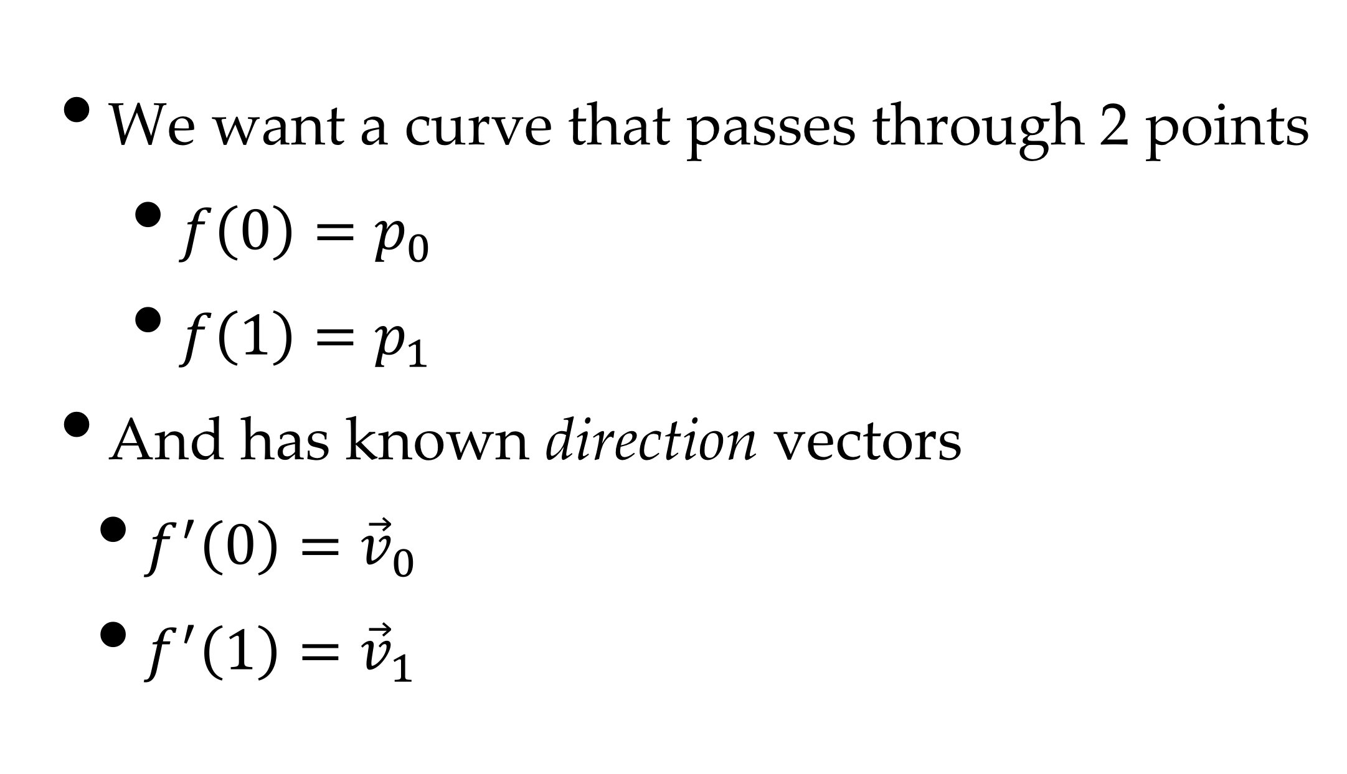
Hermite Conditions
We want a curve that passes through 2 points
$f\left(0\right)=p_{0}$
$f\left(1\right)=p_{1}$
And has known direction vectors
$f^{′}\left(0\right)={\vec{v}}_{0}$
$f^{′}\left(1\right)={\vec{v}}_{1}$

Slide 15
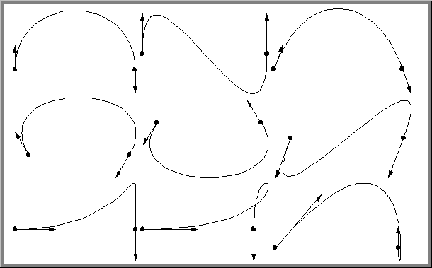
Hermite Examples
©T. Munzner, UBC

Slide 16

Hermite Example

Slide 17
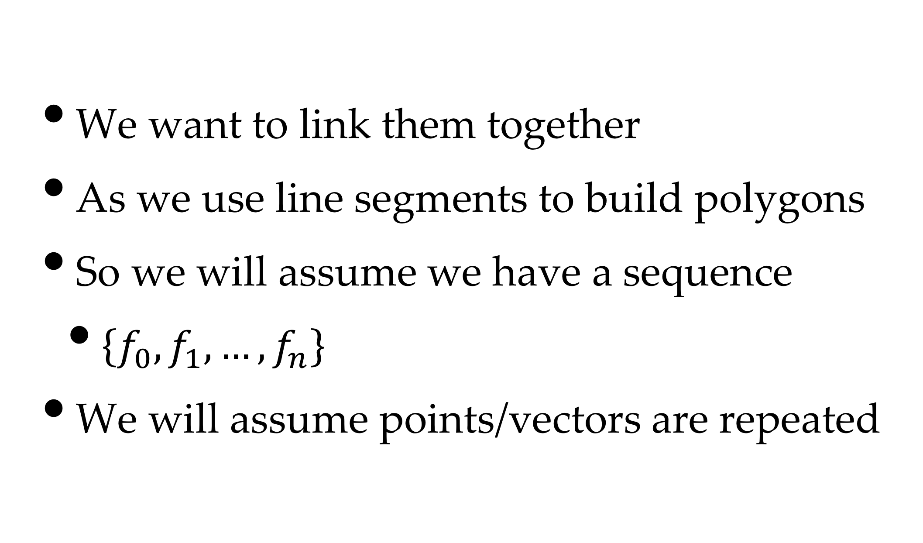
Piecewise Hermites
We want to link them together
As we use line segments to build polygons
So we will assume we have a sequence
$\left\{f_{0},f_{1},…,f_{n}\right\}$
We will assume points/vectors are repeated

Slide 18
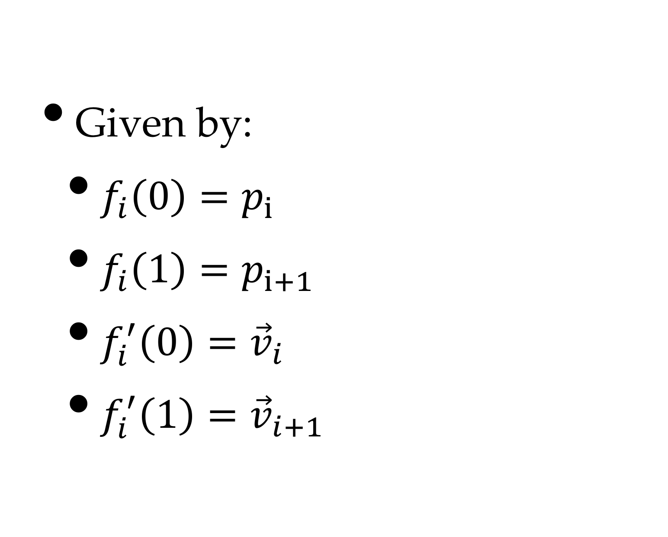
Cubic Hermite Curves
Given by:
$f_{i}\left(0\right)=p_{i}$
$f_{i}\left(1\right)=p_{i+1}$
$f_{i}^{′}\left(0\right)={\vec{v}}_{i}$
$f_{i}^{′}\left(1\right)={\vec{v}}_{i+1}$

Slide 19
Development

Slide 20
Finally!!
Basis
matrix M
Geometry matrix G
Now we have something workable
interpolating, but uses vectors

Slide 21
Basis Functions
We can plot the weight of each point/vector
as a function of parameter t

Slide 22
Bézier Curves
Arbitrary polynomial degree
Cubic Béziers are equivalent to Hermites
And can be converted to/from them
But easier to implement
And easier to generalise

Slide 23


Parametrization
t=1
t=0.5
t=1
t=0.5
t=0
t=0
t=1
t=0.5
t=0

Slide 24
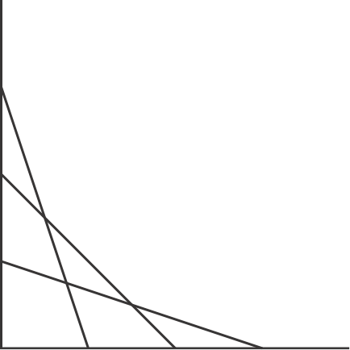
Parametrization
t=1
t=0.75
t=0.5
t=0.75
t=0.25
t=0.5
t=0.25
t=0
t=1
t=0.75
t=0.5
t=0.25
t=0

Slide 25
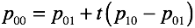
Development

Slide 26
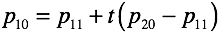
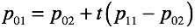
Development

Slide 27
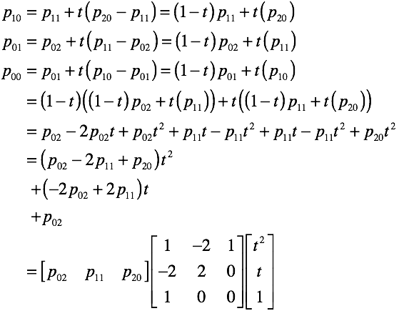
Algebra

Slide 28
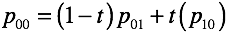
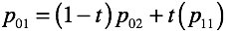
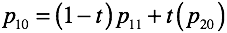
Table method
d=0 | d=1 | d=2
d=1 | d=2
d=2

Slide 29
Table method
d=0 | d=1 | d=2
d=1 | d=2
d=2

Slide 30
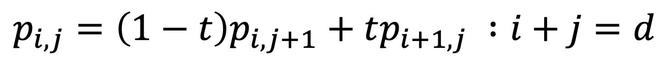
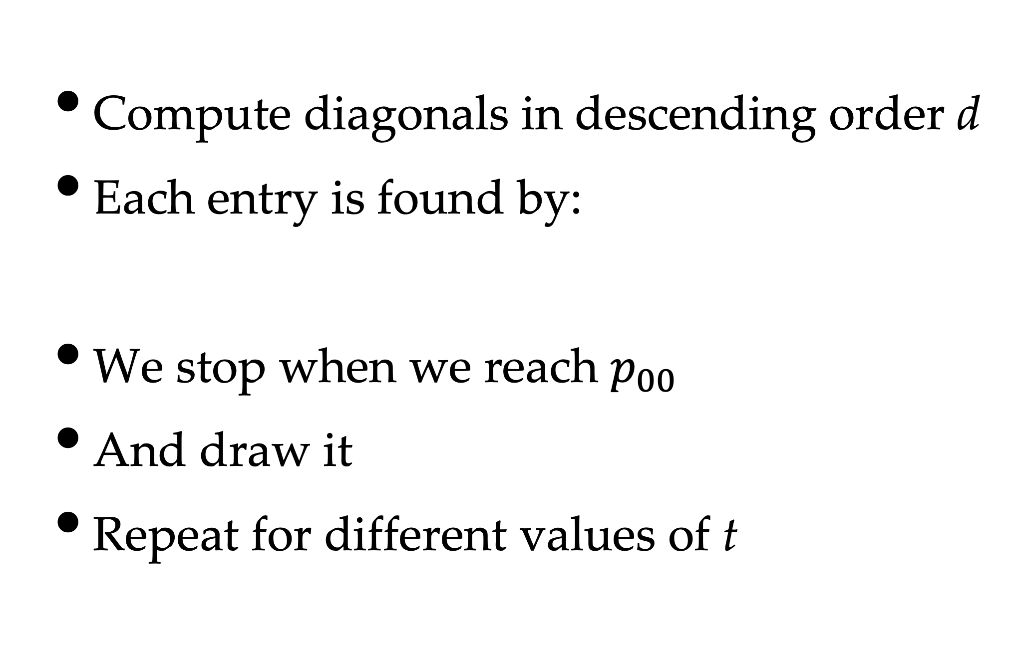
In general
Compute diagonals in descending order d
Each entry is found by:
We stop when we reach $p_{00}$
And draw it
Repeat for different values of t
$$p_{i,j}=\left(1−t\right)p_{i,j+1}+tp_{i+1,j} :i+j=d$$

Slide 31
de Casteljau Algorithm
int N_PTS = 3;
Point bezPoints[N_PTS][N_PTS];
void DrawBezier()
{ // DrawBezier()
for (float t = 0.0; t <= 1.0; t += 0.01)
{ // parameter loop
for (int diag = N_PTS-2; diag >= 0; diag--)
{ // diagonal loop
for (int i = 0; i <= diag; i++)
{ // i loop
int j = diag - i;
bezPoints[i][j] = (1.0-t)*bezPoints[i][j+1] + t*bezPoints[i+1][j];
} // i loop
} // diagonal loop
// set the pixel for this parameter value
SetPixel(bezPoints[0][0];
} // parameter loop
} // DrawBezier()

Slide 32
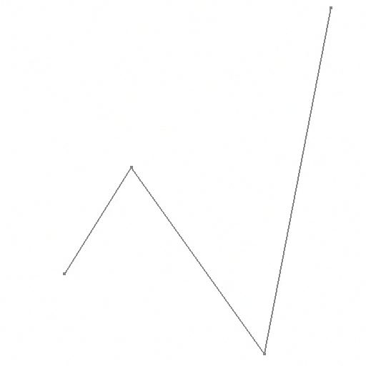
de Casteljau Example

Slide 33
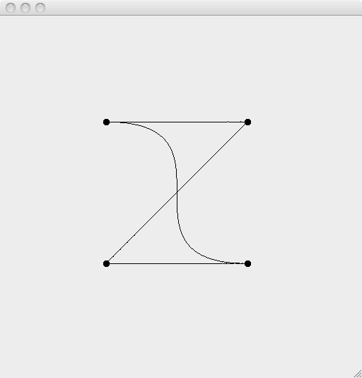
Bézier Control Polygons
The points are the control points
The lines are the control polygon
although they're actually a polyline
Control
Point
Control
Point
Bézier
Curve
Control
Polygon
Control
Point
Control
Point

Slide 34
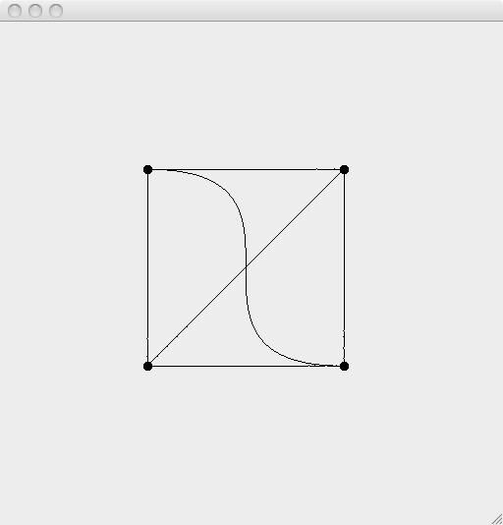
Bézier Convex Hull
Bézier uses linear interpolation
i.e. along lines
Which means:
it's bounded
by the convex hull
Control
Point
Control
Point
Bézier
Curve
Control
Polygon
Convex
Hull
Control
Point
Control
Point

Slide 35
Properties of Béziers
Smooth - C∞
Interpolate through endpoints
Bounded - convex hull property
Efficient - repeated linear interpolation
Numerically stable
Easy to control

Slide 36
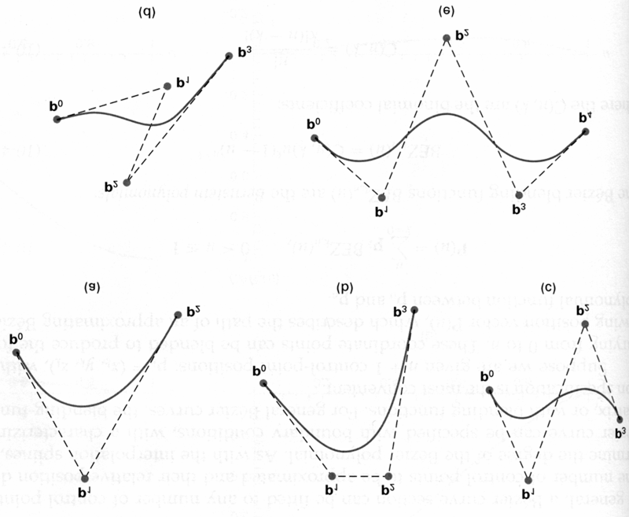
Some Examples
©T. Munzner, UBC

Slide 37
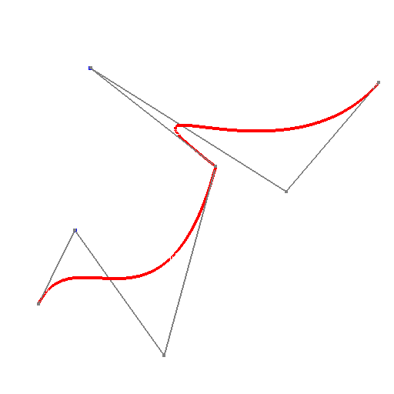
Piecewise Béziers
Convenient, but
not C¹ continuous
we want slopes to match
unless we want sharp turns/corners

Slide 38
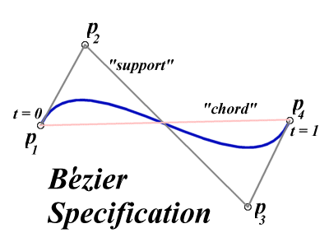
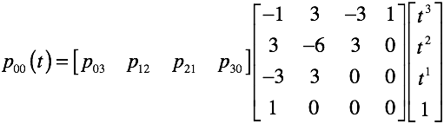
Cubic Bézier Curves
Curves defined by 4 points
Curve passes through two points
contained in convex hull of points
©T. Munzner, UBC

Slide 39
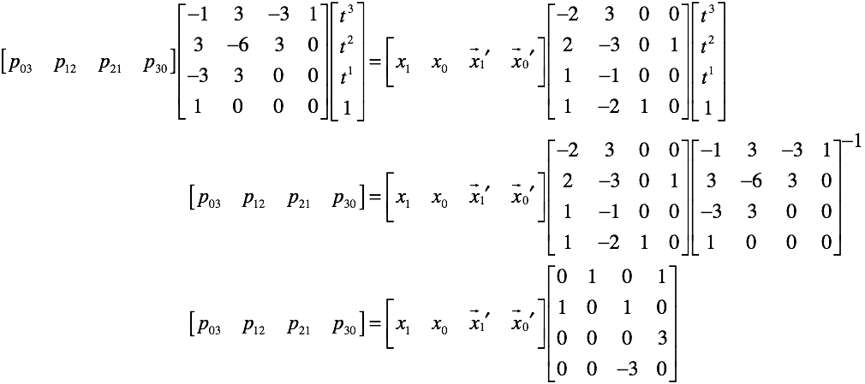
Conversion
Hermites can be converted to Béziers

Slide 40
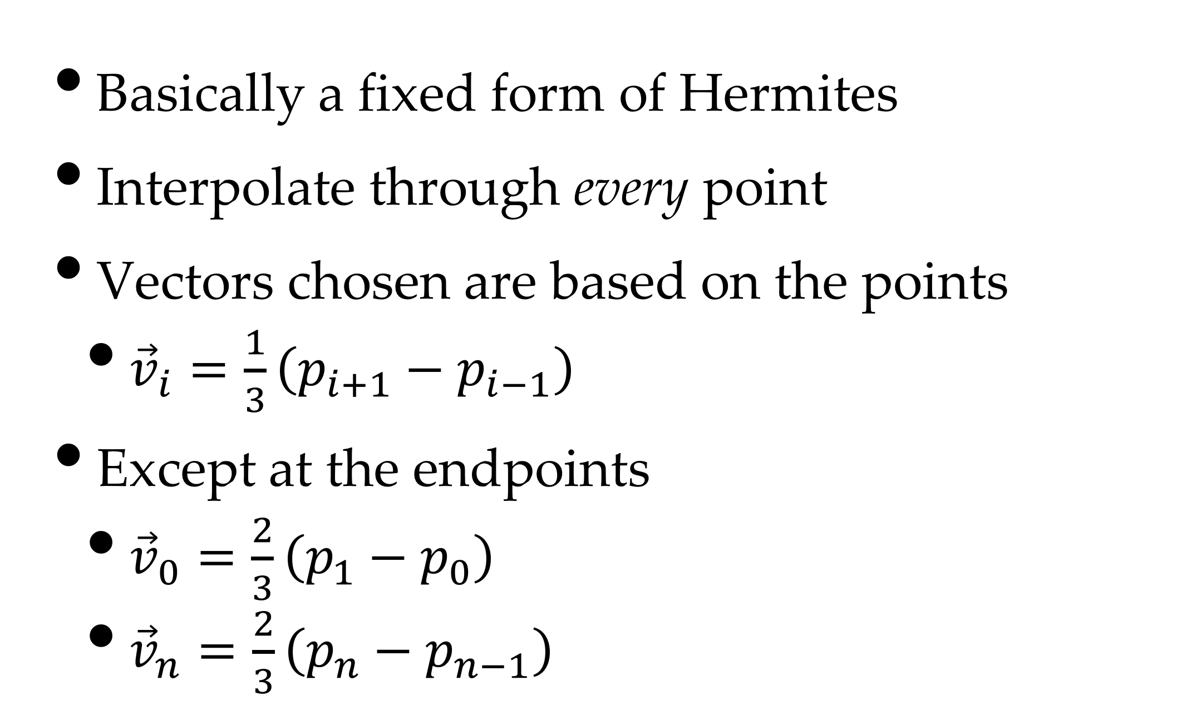
Catmull-Rom Splines
Basically a fixed form of Hermites
Interpolate through every point
Vectors chosen are based on the points
${\vec{v}}_{i}=\frac{1}{3}\left(p_{i+1}−p_{i−1}\right)$
Except at the endpoints
${\vec{v}}_{0}=\frac{2}{3}\left(p_{1}−p_{0}\right)$
${\vec{v}}_{n}=\frac{2}{3}\left(p_{n}−p_{n−1}\right)$

Slide 41
Catmull-Rom Weights

Slide 42
Terminology
Notice we have a sequence of points
Which defines a sequence of curves
And we reuse points along the sequence
At integer parameter values called knots
We can generalise this further
With cubic B-splines

Slide 43
Cubic B-splines
Generalise Bézier/Hermite/Catmull-Rom
Reuse individual control points (knots)
More efficient
Identical to Bézier geometry matrix
except for last row

Slide 44
Non-Uniform B-Splines
Non-Uniform B-Splines
Knots are not evenly spaced
So we add t_{i} term to represent parameters
And we can repeat a point p_{i}
Which allows us to have sharp corners
But we can't represent circles
Or other conic sections

Slide 45
NURBS
Non-Uniform Rational B-Splines
Add the homogeneous coordinate w
As a function of t
Allows conic sections
And survives projection!
So we can project, then intersect

Slide 46
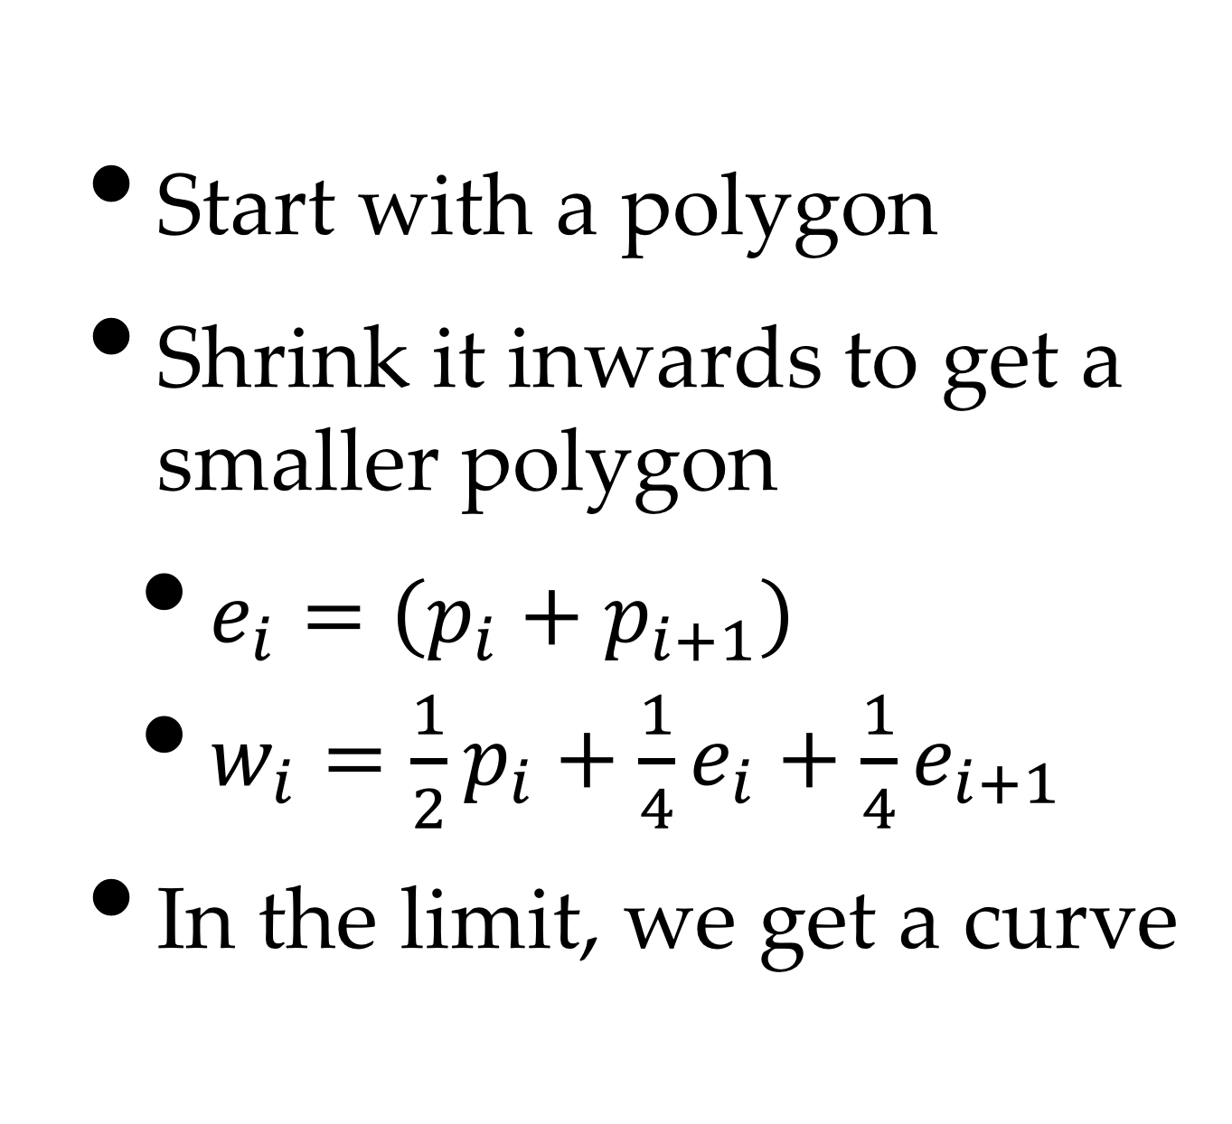
Subdivision Curves
Start with a polygon
Shrink it inwards to get a smaller polygon
$e_{i}=\left(p_{i}+p_{i+1}\right)$
$w_{i}=\frac{1}{2}p_{i}+\frac{1}{4}e_{i}+\frac{1}{4}e_{i+1}$
In the limit, we get a curve

Slide 47
Editing Subdivision Curves
Start with a simple shape
For example, an oval:
At the second level
Move some nodes
To create a "nose"

Slide 48
Equivalence
If we take the limit, we get a cubic curve
And it's exactly the cubic B-spline

